Slide 1
❋
BUMBY WOOL
KPI Framework & Analytics
Turning fragmented Shopify, marketing, and web data into decisions a small team can act on
Data Analytics Capstone · MGMT 6219 · Riipen Industry Project
Group 6 — Baranitharan Balraju · Marvelous Chidiebube Ihedigbo · Rahul · Arun Saji · Antony Boon Clinu Mangatt Raju
Notes:
Good afternoon. We're Group 6, and over the past several weeks we've been working with Bumby Wool, a Canadian sustainable wool brand, to build them a KPI system out of data that's currently scattered across three platforms. I'll walk you through what we found and what we recommend.

Slide 2
Platforms, no single view
The core problem isn't missing data — it's fragmentation
🛍
Shopify
Sales, products, customers
Shopify platform reports on its own terms. No one has been stitching the stories together — so the founder can't easily see which products make money, where buyers drop off, or whether ad spend pays off.
Our job: define the few numbers that matter, and put them in one place a small team can maintain.
Notes:
Bumby Wool has plenty of data — it's just siloed. Shopify knows orders, Meta knows ads, Google Analytics knows traffic, and nobody's combining them. The founder's real questions all fall in the gaps between these platforms.

Slide 3
How we approached it
A current-state analytics project, not a modelling exercise
1
→
2
→
3
→
4
→
5
Clean & govern
Explore
Frame KPIs
Build dashboard
Recommend
Stripped all PII; flagged test orders & outliers
Revenue, order value, product mix, segments
12 metrics across sales, product, customer, marketing
Interactive Power BI with slicers & drill-through
Quick wins + the tracking foundation
Tools kept deliberately light: Excel & Python for cleaning · Power BI for the model, DAX and dashboard · Word & PowerPoint for reporting. Everything reproducible from a standard Shopify export — no paid connectors.
Notes:
We treated this as describing the current state clearly, rather than forecasting — with only 3.5 months of data, that's the honest and useful call. Five stages, from cleaning through to recommendations, with a light toolset a small business can actually maintain.

Slide 4
The snapshot
Apr 1 – Jul 13, 2026 · 151 revenue orders (14 test orders excluded) · USD
$27,618
$101
14%
75%
Total revenue
Median order value
Repeat-buyer rate
Orders ship to the U.S.
Revenue is growing month over month — but it's early, and a couple of numbers below the surface matter more than the totals.
Notes:
Here's the headline. About 27.6 thousand dollars in revenue over 151 orders. We lead with the 101 dollar median, not the 183 dollar average, because one genuine bulk order skews the mean. Two numbers to remember: only 14% of buyers come back, and three quarters of orders ship to the U.S.

Slide 5
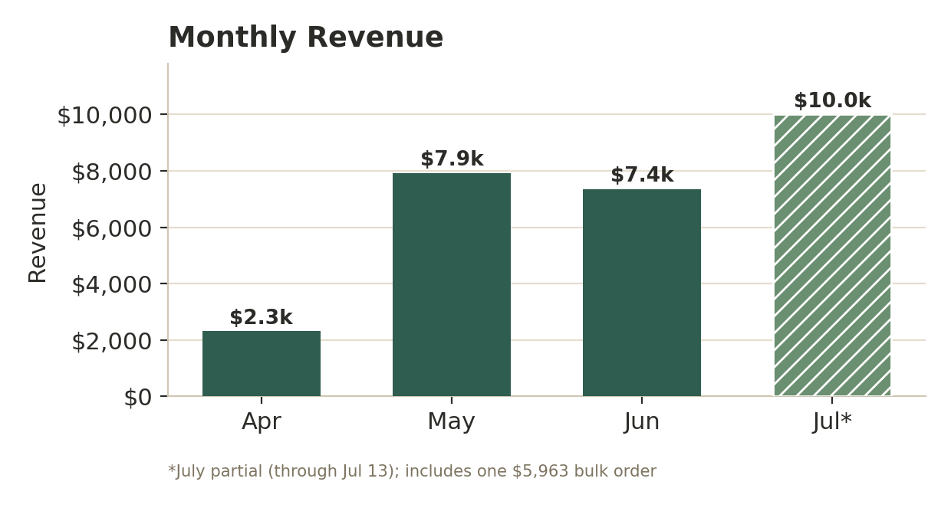
Revenue climbed through the spring
Steady April-to-June growth is the reliable signal
What it means
Apr → Jun grew steadily: $2.3k → $7.9k → $7.4k
July looks highest, but it's a partial month (through the 13th)…
…and inflated by one $5,963 bulk order
Read the spring climb as momentum, not July as a spike
Notes:
Revenue roughly tripled from April to May and held in June. July shows the biggest bar, but that's misleading twice: it's only half a month, and it contains that one big bulk order. The real story is the steady spring growth.

Slide 6
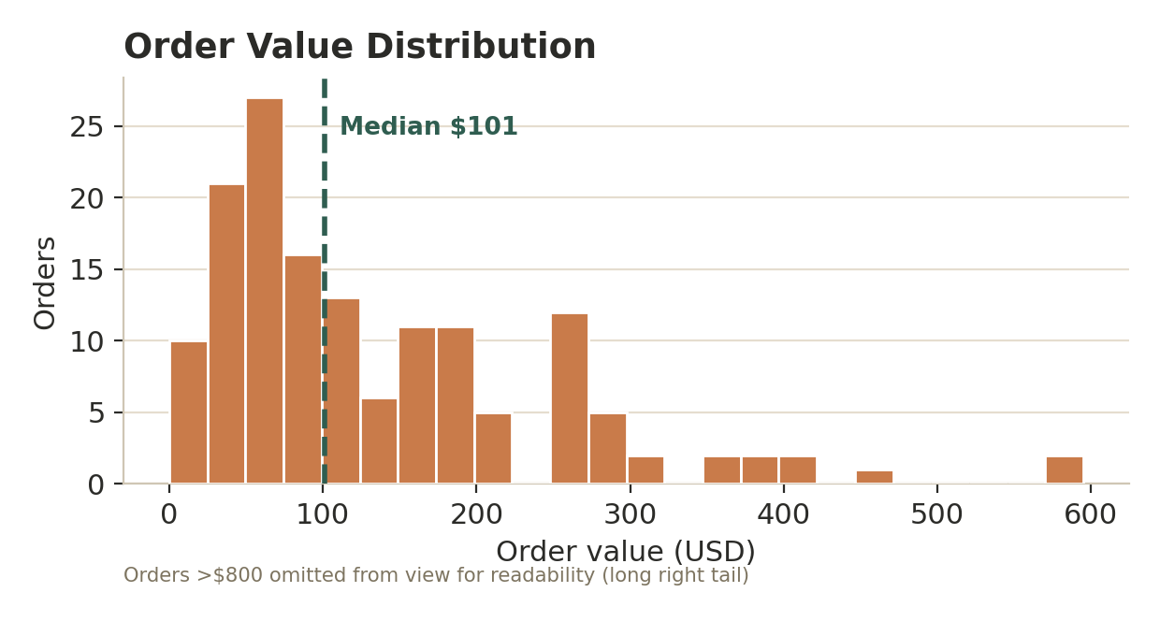
The average hides the typical order
Why we report the median, not the mean
$183
$101
mean
median
Most orders fall between $50 and $200. A thin tail of large orders drags the average up — so the $101 median is the number to watch. The mean lurches every time a wholesale-style order lands.
Notes:
This histogram is why we keep pointing at the median. Most orders cluster under 200 dollars, but a few large ones pull the mean up to 183. For a business this size, 101 dollars is the honest 'typical order' figure.

Slide 7
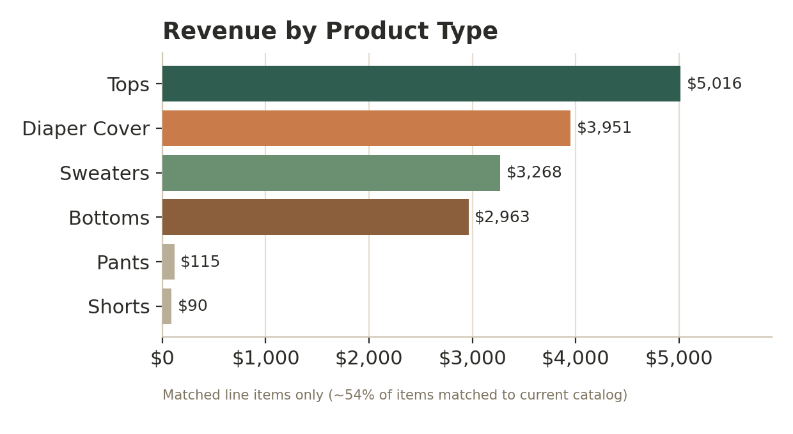
A few categories carry the revenue
Tops and Diaper Covers lead — read as directional
Takeaways
Tops (~$5.0k) and Diaper Covers (~$4.0k) are the clear leaders
Sweaters and Bottoms follow close behind
Only ~54% of items matched the catalog, so this is directional
Still: a small set of categories does most of the work
Notes:
Among items we could match to the catalog, Tops and Diaper Covers lead. We're careful to call this directional because catalog matching was only about 54% — part of the strength here is cleaner tagging. But the concentration is real and worth acting on.

Slide 8
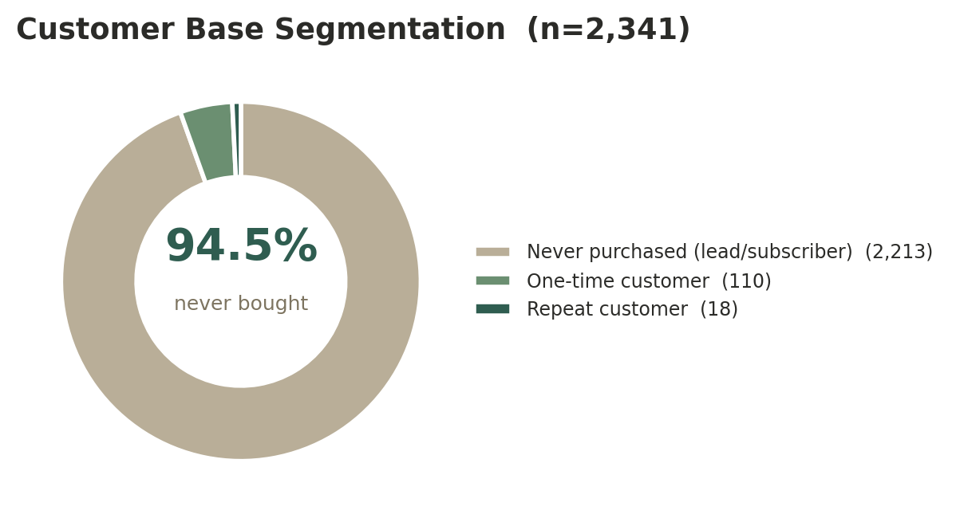
The biggest opportunity: retention
14%
of buyers come back for a second order (18 of 128)
Repeat customers are far cheaper to sell to than new ones. Lifting repeat purchasing from 14% toward 20% would grow revenue without spending a dollar more on acquisition.
Notes:
This is the finding with the most upside. Of the 128 people who've actually bought, only 18 have come back. Retention is a cheaper lever than acquisition, so even a small lift here compounds. Several of our recommendations aim right at this.

Slide 9
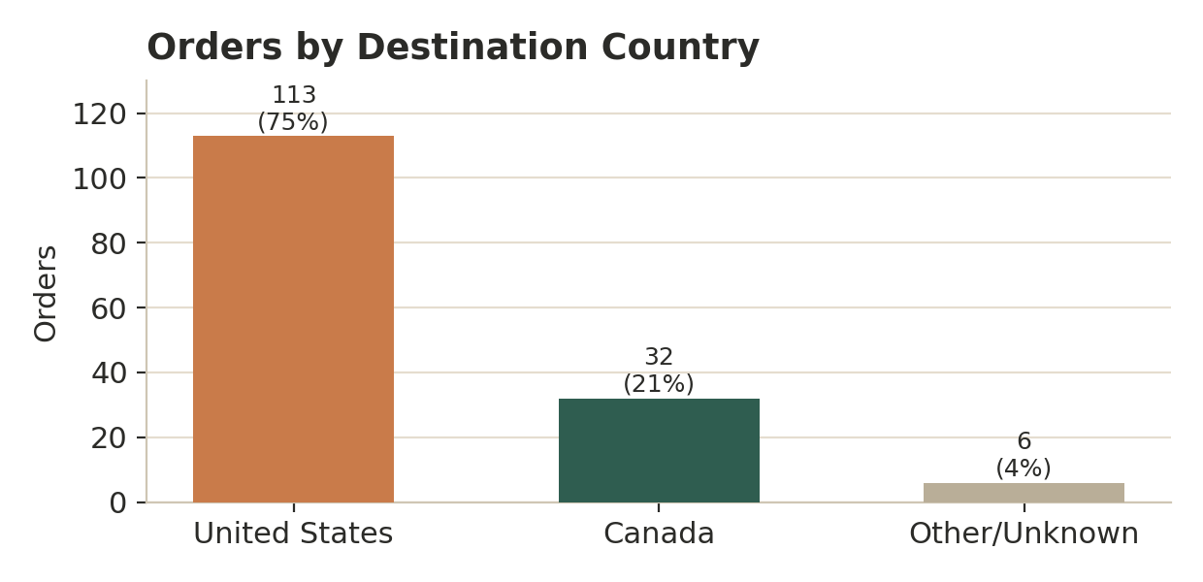
A Canadian brand serving America
A strategic fact hiding in plain sight
So what?
75% of orders ship to the U.S. (113 of 151)
21% to Canada; every order is priced in USD
Shapes shipping, currency & tax handling
And where ad spend should be pointed once Meta data is connected
Notes:
Here's something that wasn't even on the original question list. Three quarters of orders go to the United States, and everything's priced in USD. For a Red Deer brand, that reframes shipping, pricing, and where advertising should focus.

Slide 10
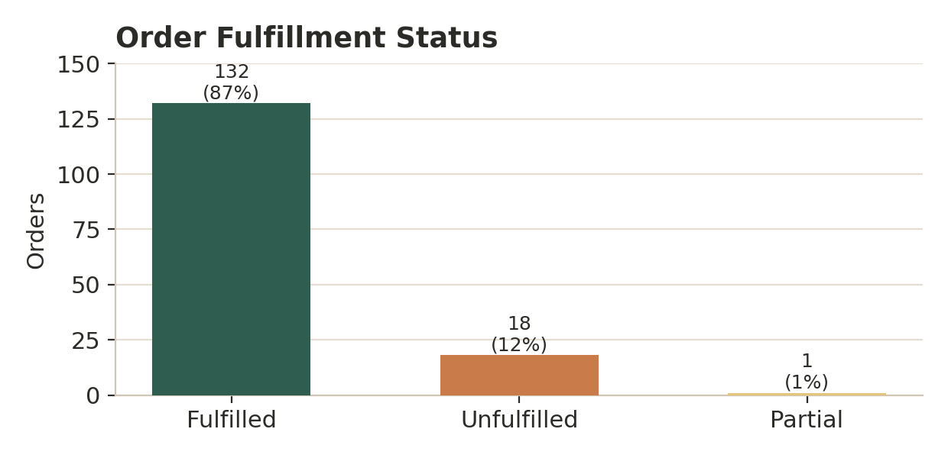
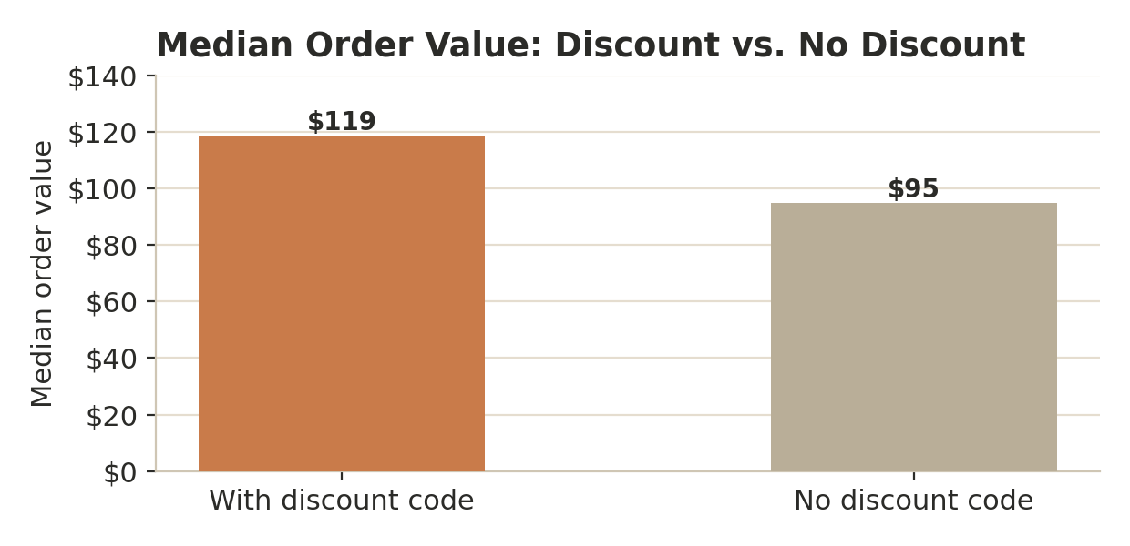
Operations and discounting look healthy
One thing to watch, one pleasant surprise
87% of orders fully fulfilled — keep an eye on the open ~13%.
Discounted orders are larger ($119 vs $95), not smaller — codes drive bigger baskets.
Notes:
Operationally, 87% fulfilled is solid; we'd just watch the open 13% so it doesn't creep up. And a pleasant surprise on discounts: coded orders are actually bigger than uncoded ones, so discounting looks disciplined rather than margin-eroding.

Slide 11
What we can't answer yet — and why
Being upfront is part of doing this responsibly
⏱
Short window
🔗
Catalog gap
~3.5 months — too short for seasonality claims
~46% of line items didn't match the catalog
📣
No ad/web data
👥
Mixed list
Meta & GA4 weren't in this export
94.5% of customer records never bought
Ad efficiency (ROAS/CPA) and the on-site funnel are defined in our KPI framework and left as dashboard placeholders — they populate the moment Meta & GA4 are connected.
Notes:
We'd rather show a clearly labelled gap than publish numbers we can't stand behind. Two of the founder's questions — ad efficiency and the funnel — need Meta and Google Analytics data that wasn't in this export. They're built into the framework, ready to light up once that data is connected.

Slide 12
What we recommend
Ordered by impact versus effort
Quick wins — act now
Foundations — unlock the full picture
Build a post-purchase email flow to lift repeat buying toward 20%
Lean into Tops & Diaper Covers — inventory, placement, bundles
Treat the U.S. as the primary market, deliberately
Keep discounting, but tag campaigns to track what works
Fix product naming & SKUs at the source (closes the catalog gap)
Connect Meta & GA4 into the reporting model
Adopt the dashboard as a weekly habit
Revisit seasonality once a full year of clean data exists
Notes:
Our recommendations split in two. On the left, things Bumby Wool can do now with the Shopify data — the retention email flow is the highest-leverage. On the right, the foundational fixes, mostly about tracking hygiene, that unlock the marketing and funnel picture. The SKU fix is unglamorous but it's the single biggest constraint we hit.

Slide 13
❋
Where this goes next
Stand up the Meta & GA4 feeds
Rebuild the product view on a clean SKU system
Validate retention & discount patterns on a larger sample
The infrastructure is built to absorb these without a rebuild.
Thank you — questions welcome.
Group 6 · MGMT 6219 · Bumby Wool
Notes:
To wrap up: the immediate next steps are connecting the marketing and web feeds, rebuilding product reporting on clean SKUs, and validating our patterns on more data. None of it needs heavy tooling — mostly consistency in how data is captured. Thank you, and we're happy to take questions.

